Slide 1

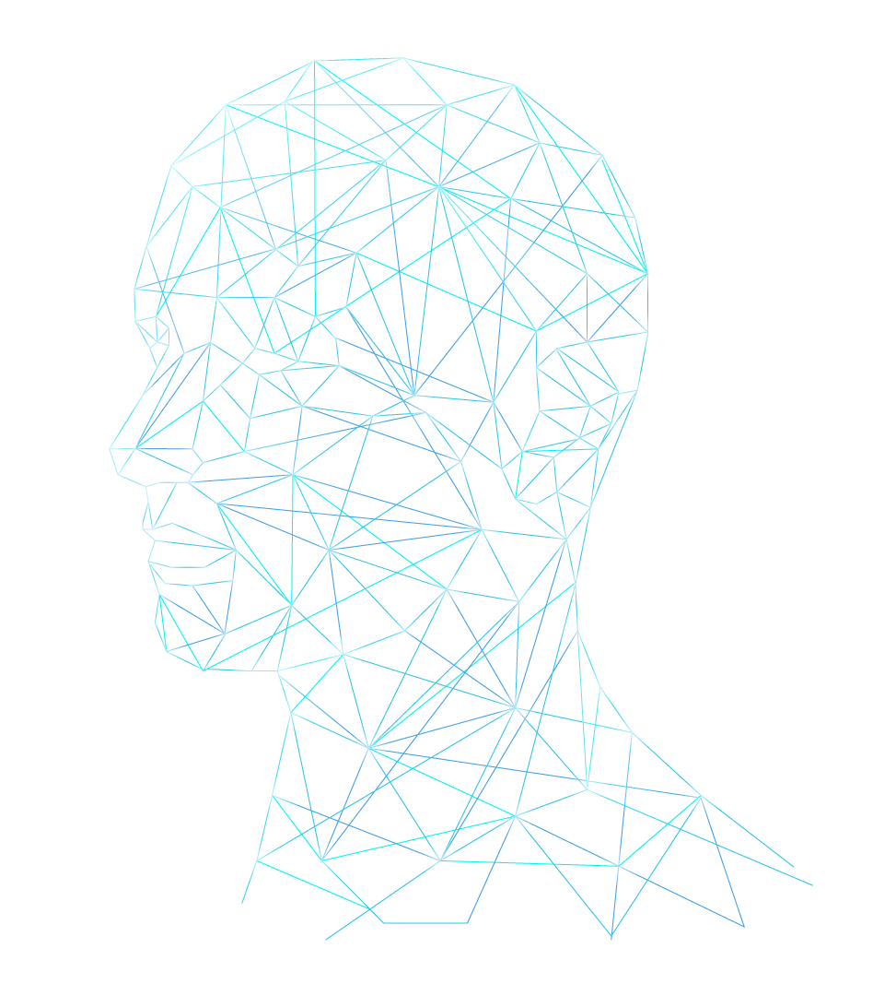
Convolutional Neural Network (CNN)
Presented By:
Maria Sharif 059
Sareena Bilal 318
Presented To:
Dr. Areej Fatima

Slide 2

INTRODUCTION
A Convolutional Neural Network (CNN) is a type of artificial neural network designed for processing structured grid data, such as images and videos.
The primary purpose of a CNN is to efficiently and automatically learn hierarchical representations of features from input data.
In the context of image processing, CNNs excel at tasks like image classification, object detection, and image segmentation
Popular CNN architectures include LeNet, AlexNet, VGGNet, GoogLeNet, DenseNet, MobileNet ,and ResNet.

Slide 3
Characteristics of CNN
1
Convolutional Layers
8
Feature Maps
2
Pooling Layers
Dropout
9
3
Fully Connected Layer
Loss Function
10
4
Activation Functions
11
Optimization Algorithms
5
Weight Sharing
12
Softmax
6
Stride
7
Padding

Slide 4
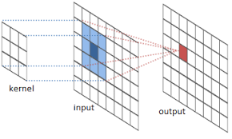
CONVOLUTIONAL LAYERS
CNNs use convolutional layers to scan an input
image or feature map using small, learnable filters
(kernels).
These filters slide over the input data, applying
convolution operations to detect patterns and
features.
Convolutional layers are responsible for feature
extraction.

Slide 5
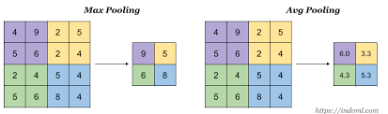
POOLING LAYERS
The main purpose of pooling layer is to progressively reduce the
spatial size of the input image, so that number of computations in the
network are reduced.
Pooling performs down sampling by reducing the size and sends only
the important data to next layers in CNN.

Slide 6
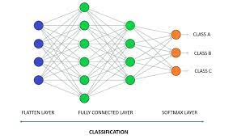
FULLY CONNECTED LAYERS
Fully connected layers are used to perform high-level reasoning and
classification.
These layers take the output from the previous layers and map it to the
desired output, such as class probabilities.

Slide 7
ACTIVATION FUNCTIONS
An activation function is a mathematical operation applied
to each neuron's output in a neural network layer.
Activation functions introduce non-linearities to the network, allowing it to learn complex patterns and relationships in the data.

Slide 8
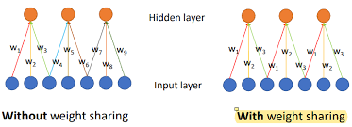
WEIGHT SHARING
Weight sharing is a way to reduce
the number of parameters while
allowing for more robust feature
detection.
This property enables the network
to recognize patterns anywhere
in the image.

Slide 9
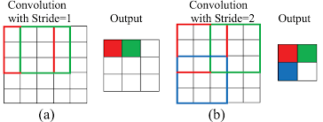
STRIDE
Stride is the number of pixels shifts over the input matrix. When the
stride is 1 then we move the filters to 1 pixel at a time.
When the stride is 2 then we move the filters to 2 pixels at a time and so on.

Slide 10
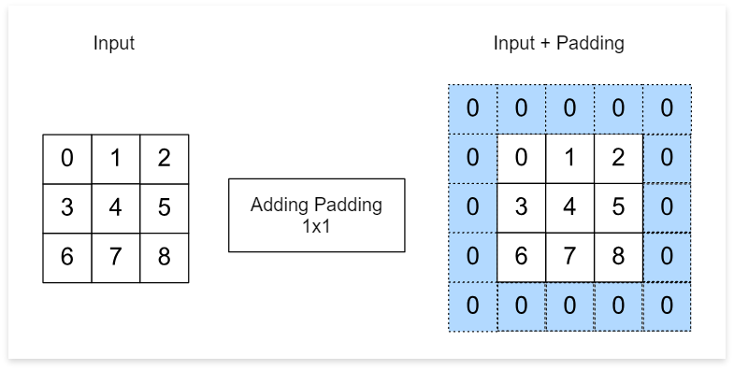
PADDING
Padding in CNN refers to the addition of
extra pixels around the borders of the
input images or feature map.
Adding padding to an image processed by
a CNN allows for more accurate analysis
of images.

Slide 11
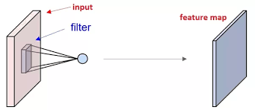
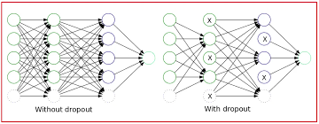
FEATURE MAPS AND DROPOUT
Feature mapping involves selecting or designing a set of functions that
map the original data to a new set of features.
Dropout layers are sometimes used to prevent overfitting.

Slide 12
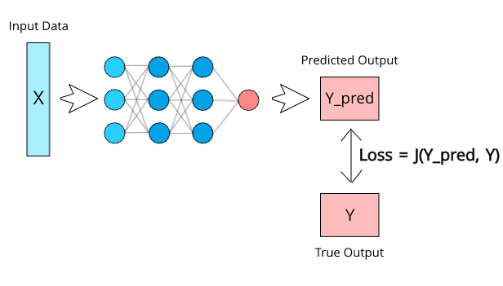
LOSS FUNCTION
CNNs are typically trained using a loss function that measures the difference
between predicted and actual values (to prevent over fitting).
It measures the model's performance and guides the optimization process by
providing feedback on how well it fits the data.

Slide 13
OPTIMIZATION ALGORITHMS
In deep learning, optimizers are algorithms that adjust the model’s
parameters during training to minimize a loss function.
They enable neural networks to learn from data by iteratively updating
weights and biases.
Common optimizers include Stochastic Gradient Descent (SGD) and
Adam.

Slide 14
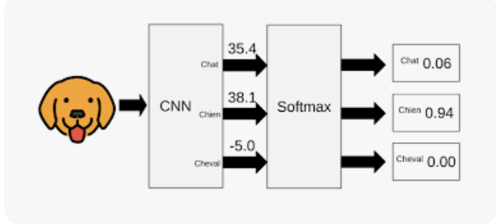
SOFTMAX
The softmax function is commonly used in the output layer to generate class probabilities for multiclass classification problems.
It is usually placed as the last layer in the CNN model.

Slide 15
LIMITATIONS OF CNN
Limited Understanding of Global Context
Data Dependency and Overfitting
Computational Intensity
Lack of Interpretability
Not Universally Applicable
Vulnerability to Adversarial Attacks
Large Memory Requirements
Difficulty in Handling Sequential Data

Slide 16
APPLICATIONS OF CNN
Image Classification
Facial Recognition
Natural Language Processing (NLP)
Video Analysis
Gesture Recognition
Document Analysis

Slide 17
Object Detection
Medical Imaging
Biometric Security
Emotion Recognition
Financial Fraud Detection
Human Pose Estimation

Slide 18
Speech Recognition
Healthcare Informatics
Social Media Content Analysis
Handwriting Recognition

Slide 19
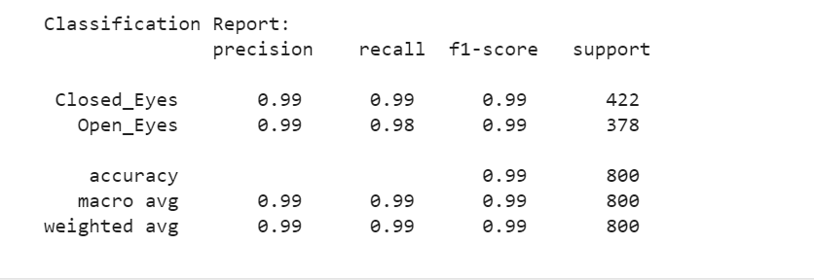
DROWSINESS DETECTION USING CNN

Slide 20


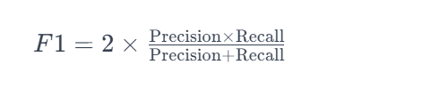

SCORES

Slide 21
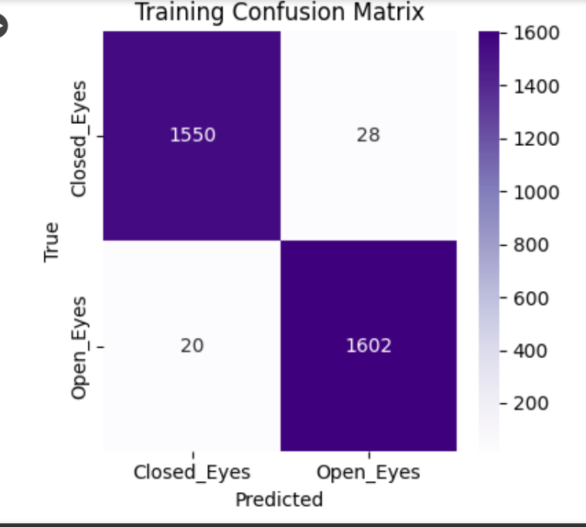

Slide 22
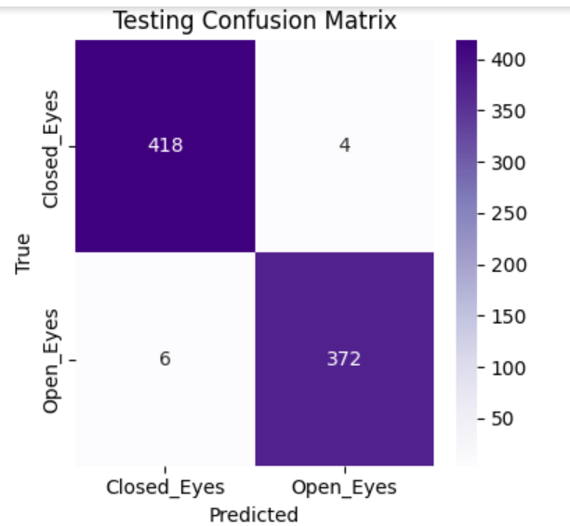

Slide 23


